Slide 1


Capstone Project
Olympics
Notes:
Hi everyone,
My name is Shiraj Ahmad,
and I'm a mentor here for data science.
In this session, I'll be explaining Power BI's Capstone Project: University Ranking.
First, congratulations on completing Excel, SQL, and Power BI.
After completing this Capstone Project, you'll be job-ready!
So, let's get started.

Slide 2
Overview
Games Analysis
Sports Analysis
Event Analysis
Participant Analysis
Medal Analysis
Regional Analysis
Notes:
Overview of Olympics Database - Games, Sports, Events, Participants, Medals, and Regional Analysis:
The Olympics database is a comprehensive dataset encompassing diverse information about the Olympic Games. This extensive collection of data allows for in-depth analysis and insights across various dimensions, including games, sports, events, participants, medals, and regional representation. By exploring these aspects, analysts, researchers, and sports enthusiasts can gain a comprehensive understanding of the Olympics' historical data and draw valuable conclusions.
Games Analysis: The Games Analysis focuses on examining the history of Olympic Games editions, including details like the year, host country, and event type (Summer or Winter Olympics). It enables researchers to study the evolution of the Games over time, identify trends in host cities, and analyze factors influencing the Games' locations and frequency.
Sports Analysis: With the Sports Analysis, researchers can delve into individual sports disciplines featured in the Olympics. It offers insights into the popularity of different sports, participation rates, and changes in the types of sports included in the Games over the years. By understanding sport-specific patterns, stakeholders can make informed decisions regarding the Games' future sporting events.
Event Analysis: The Event Analysis centers on exploring individual events within various sports disciplines. Researchers can examine event schedules, track historical results, and analyze the participation and performance of athletes. This analysis enables a deeper understanding of the significance of specific events and their impact on the overall Olympic experience.
Participants Analysis: The Participants Analysis provides valuable information about athletes, coaches, and other individuals involved in the Olympics. Researchers can study participant demographics, countries represented, and athlete performance. This analysis aids in identifying exceptional athletes, their achievements, and the diversity of participants on a global scale.
Medal Analysis: The Medal Analysis focuses on the distribution of medals won by athletes and countries across different Olympic editions. Researchers can study medal counts, assess medal-winning trends, and identify dominant countries in various sports. This analysis provides valuable insights into the competitive nature of the Games and countries' sporting prowess.
Regional Analysis: The Regional Analysis emphasizes the representation of National Olympic Committees (NOCs) and regions in the Olympics. By examining regional participation and medal outcomes, researchers can analyze the performance of regions worldwide. This analysis sheds light on the global impact of the Games and celebrates the accomplishments of diverse nations.
In conclusion, the Olympics database offers a wealth of data to analyze and understand the historical aspects of the Olympic Games. By conducting games, sports, event, participant, medal, and regional analyses, researchers can gain valuable insights into the Games' evolution, athletic achievements, and the global significance of this premier sporting event.

Slide 3

Problem Statement
Objective
Analysis Scope
Goal
Insights & Recommendations.
Report & Presentation
Notes:
Objective:
The objective of analyzing the Olympics database is to gain valuable insights into the historical data of the Olympic Games. This analysis aims to explore various dimensions, including games, sports, events, participants, medals, and regional representation, to understand the evolution of the Games and extract meaningful patterns from the data.
Analysis Scope:
The analysis scope encompasses a comprehensive examination of the Olympics database, covering data from multiple editions of the Olympic Games. It includes analyzing records related to games editions, sports disciplines, individual events, participants' information, medal outcomes, and the representation of different regions worldwide.
Goal:
The primary goal of this analysis is to provide a detailed overview of the Olympic Games' historical data. By conducting extensive research and exploration, the aim is to identify trends, patterns, and significant insights from different aspects of the Games. The analysis seeks to present a cohesive narrative that showcases the rich history and evolution of the Olympics.
Insights and Recommendations:
The analysis aims to generate valuable insights from the data, such as identifying trends in host cities, evaluating the popularity and evolution of sports disciplines, recognizing outstanding athletes' achievements, and assessing the performance of regions and countries. Based on these insights, recommendations can be made to enhance future Olympic Games' organization, sports selection, and representation of diverse regions.
Report and Presentation:
The final deliverable will be a comprehensive report and presentation that presents the findings of the Olympics database analysis. The report will include detailed visualizations, statistical analyses, and data-driven insights from the various dimensions explored. The presentation will provide an engaging overview of the key findings, showcasing the historical significance and impact of the Olympic Games over time.
In conclusion, the analysis of the Olympics database aims to unravel the rich historical data of the Games, drawing meaningful insights, and providing recommendations to enhance the Olympics' future editions. Through a comprehensive report and presentation, the analysis will contribute to a deeper understanding and appreciation of the world's premier sporting event.

Slide 4


Significance
Valuable insights
Improvement focus
Evaluation of effectiveness
Trend identification
Comprehensive understanding
Notes:
Significance of the Olympics Database Analysis:
Valuable Insights: Analyzing the Olympics database yields valuable insights into the historical data of the Olympic Games. Researchers can extract trends, patterns, and performance metrics from various dimensions like games, sports, events, participants, medals, and regional representation. These insights help stakeholders understand the Games' impact, identify standout athletes, and recognize influential sporting events.
Improvement Focus: By evaluating past Olympic Games editions, the analysis can shed light on areas that require improvement. Insights into host city selection, sports popularity, and regional representation can guide future Olympics organizers in making informed decisions to enhance the Games' overall experience and relevance.
Evaluation of Effectiveness: The Olympics database analysis allows for an assessment of the effectiveness of past Games editions. Researchers can evaluate the impact of specific events, the success of diverse sports, and the distribution of medals among different countries. This evaluation aids in understanding the Games' global reach and significance in fostering international sportsmanship.
Trend Identification: The analysis of historical Olympic data enables the identification of long-term trends and changes in the Games. Researchers can uncover trends in host city preferences, the introduction or removal of sports disciplines, and shifts in the geographic representation of participating countries. Understanding trends assists in predicting future developments and adapting strategies accordingly.
Comprehensive Understanding: The Olympics database analysis offers a comprehensive understanding of the Games' evolution and historical significance. By examining multiple aspects of the Olympics, researchers gain a holistic view of how the Games have evolved over time and how they have shaped the world's sporting landscape.
In conclusion, the significance of analyzing the Olympics database lies in its potential to provide valuable insights, guide improvements, evaluate effectiveness, identify trends, and offer a comprehensive understanding of the historical Olympic Games. This analysis contributes to the appreciation of the Games' global impact and aids in strategic decision-making for future editions.

Slide 5
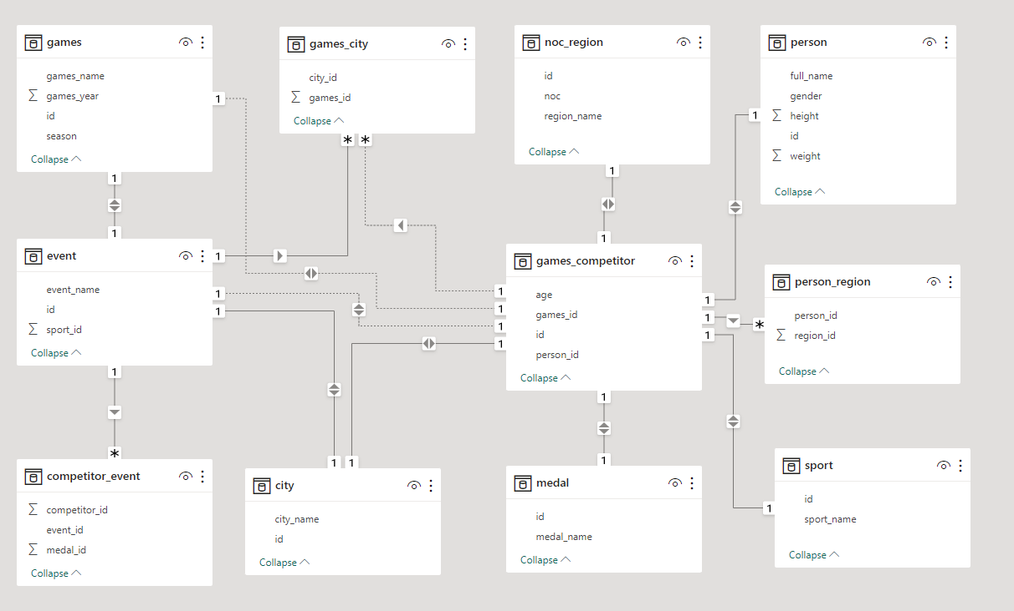
ER Diagram
Notes:
Now that we have comprehended the problem statement and recognized the significance of the project, let's delve into a thorough understanding of the dataset.
The Entity-Relationship (ER) diagram for the presentation of the Olympics database visually represents the relationships and interactions between various entities (tables) in the database. Here's an explanation of the ER diagram based on the provided tables:
1. Entities:
- Games: Represents individual editions of the Olympic Games. Each game is identified by a unique game ID and contains attributes such as the year of the event and whether it is a Summer or Winter Olympics.
- Games_City: Links Olympic Games editions to the host city where the event took place. This table stores information about the city's name, country, and other relevant details.
- NOC_Region: Represents the National Olympic Committees (NOCs) and their respective regions. Each NOC is identified by a unique NOC code, and the region they belong to is recorded in this table.
- Person: This entity contains information about individuals participating in the Olympics, including athletes, coaches, and other personnel. Each person is identified by a unique person ID and may have attributes such as their name, birthdate, and nationality.
- Person_Region: Establishes the relationship between individuals (persons) and their corresponding NOC and region. It serves as a junction table that connects individuals with their respective NOCs and regions.
- Sport: Represents various sports disciplines offered in the Olympics, such as athletics, swimming, gymnastics, etc. Each sport is identified by a unique sport ID and may have attributes like the sport's name and description.
- Games_Competitor: Links athletes (competitors) to specific Olympic Games editions, indicating their participation in the event. This table associates individual athletes with the games they competed in.
- Medal: Stores information about medals awarded to athletes during the Olympics. Each medal is identified by a unique medal ID and may have attributes indicating the type of medal (gold, silver, bronze) won by an athlete in a specific event.
- City: Represents cities worldwide, including their names and geographical information. This entity is used to link Olympic Games editions with the host city, establishing a relationship between Games_City and Games tables.
- Competitor_Event: Connects individual athletes (competitors) with the specific events they participate in during the Olympics. This table links athletes to the events they compete in.
- Event: Contains details about individual events within various sports disciplines, such as event names and schedules. This entity is linked to both the Sport and Games tables, representing events within specific sports during particular Olympic Games editions.
2. Relationships:
- Games - Games_City - City: These relationships represent the association between Olympic Games editions and their respective host cities. The Games_City table acts as a junction table to connect Games and City entities.
- NOC_Region - Person_Region - Person: These relationships establish the connection between individuals (persons) participating in the Olympics and their corresponding NOCs and regions. The Person_Region table serves as a junction table to connect Person and NOC_Region entities.
- Games - Games_Competitor - Person: These relationships link Olympic Games editions with individual athletes (competitors) participating in those events. The Games_Competitor table serves as a junction table connecting Games and Person entities.
- Person - Competitor_Event - Event: These relationships connect individual athletes (competitors) with specific events they participate in during the Olympics. The Competitor_Event table serves as a junction table connecting Person and Event entities.
- Games - Event: This relationship associates individual events with the specific Olympic Games editions they are part of.
- Event - Sport: This relationship links individual events with the sports disciplines they belong to.
- Person - Medal: This relationship connects athletes with the medals they have won during the Olympics.
The ER diagram visually presents the structure and relationships of the Olympics database, making it easier to understand the data model and data relationships within the context of the Olympic Games. It provides a comprehensive view of how different entities are connected, contributing to a holistic understanding of the Olympic Games' historical data.
I trust that you now have a clear understanding of the Capstone project requirements.

